Slide 1
Asahi PTCA guidewires and Microcatheters : BRANDS

Slide 2
Asahi Brand Range
Workhorse | Specialty | CTO | Micro Catheter | Purpose built
Sion | Fielder XT-A | Miracle 3,6,12 | Caravel 135/150 | RG3
Sion blue | Fielder XT-R | Conquest, Conquest pro-12 | Corsair pro/XS 135/150 | Extension- 165 cm
Sion blue es | Fielder XT | Gaia 1,2,3 | Tornus | Grand Slam
Fielder |  | Ultimate Bros 3 |  | Suoh
Fielder FC |  | Gaia Next- 1,2,3
Rinato
Sion Black

Slide 3
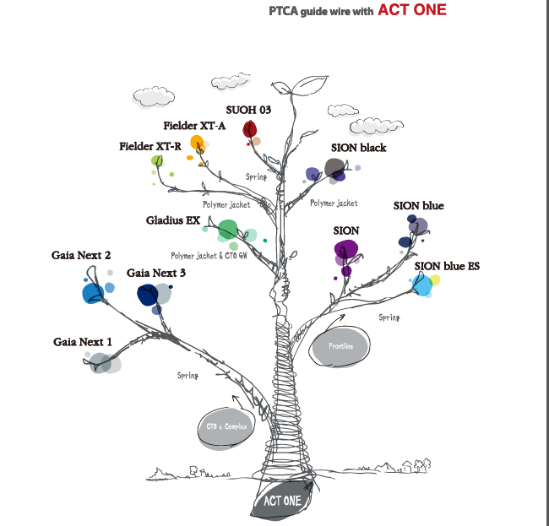

Slide 4
Type of Asahi Microcatheter
Asahi Tornus
Asahi Corsair pro and Corsair Pro XS
Asahi Caravel

